Slide 1

A mass and energy conservation analysis of CMIP6 ocean drift
Damien Irving (UNSW)
Will Hobbs
John Church
Jan Zika
Matt Palmer
Didier Monselesan
Notes:
I’m a postdoc with Jan Zika and John Church
We’ve been looking at global energy and water cycle changes in CMIP single forcing experiments.
In order to interpret the results from those forced experiments, model drift is an important consideration. We’ve therefore teamed up with Will Hobbs, Matt Palmer and Didier Monselesan (who have written papers on drift in the past) to look closely at the drift in the new CMIP6 ensemble.

Slide 2
What is drift?
Spurious unforced trends due to:
Incomplete spin up
Initial dynamical imbalance, coupling shock
Moves toward a quasi-steady state over time
Timescale: thousands of years (ocean)
Non-closure of energy or moisture budget
Referred to as “leakage”
Steady-state may not be reached
Notes:
To start, I should probably explain exactly what model drift is…
Basically “drift” is the name given to unforced trends that arise in a model simulation due to incomplete spinup and non-closure of the energy and moisture budgets.
Incomplete spinup
A simulation’s initial state may not be in dynamical balance with the representation of physics in the model
“Coupling shock’’ may occur during the coupling of model components resulting in discontinuities in surface fluxes
In these cases, a model may drift from its initial state toward a quasi-steady state over some period of time. The time scale over which the climate system adjusts will be determined by the time it takes for anomalies to be advected or mixed through the ocean, which may be many thousands of years (the adjustment of the atmosphere and land surface is many orders of magnitude faster).
Spinup periods of thousands of years are prohibitive given the available computational resources. Instead, models are generally spun up for a few hundred years. As a result, drift persists in any model.
2. Non-closure of the energy and/or moisture budget
i.e. errors or missing terms in the budget
In this case a steady solution may not be attainable.

Slide 3
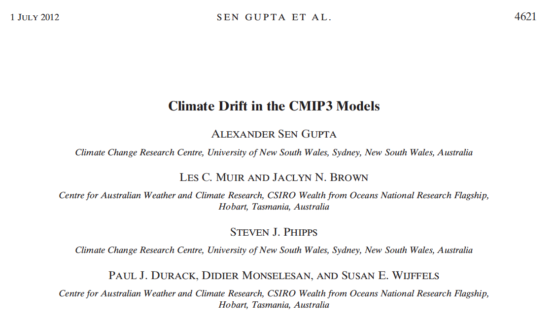
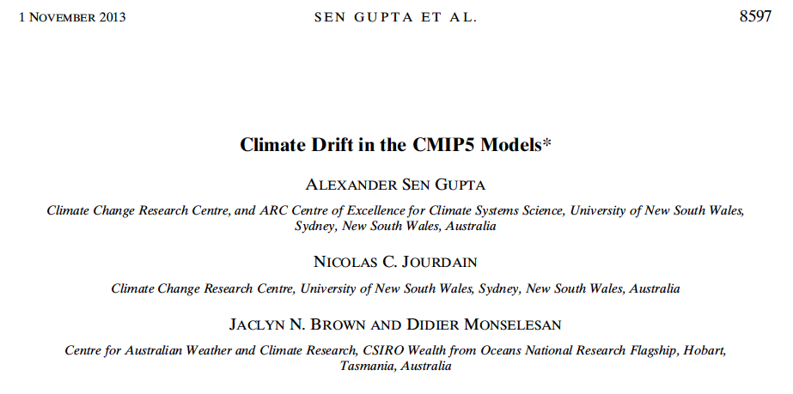
Practical insights
Drift very important for depth-integrated quantities
Steric sea level, OHC
Confusing and less important for surface variables
Improvement from CMIP3 to CMIP5
Notes:
For some reason, it’s been the Australian community that has led the way in drift research.
It started with Alex Sen Gupta and colleagues a few years ago now, who looked at the practical aspects of model drift. What I mean by that is they took a bunch of popular model variables (steric sea level, surface temperature, precipitation, sea ice) and looked at the nature of the drift (i.e. linear, cubic etc) in those variables and how large it was relative to forced trends.
In general they found that:
Drift is very important for depth integrated quantities (i.e. it represents a non-trivial fraction of forced trends)
Even though the adjustment time scale of the atmosphere is fast, as the ocean is coupled to the atmosphere, if surface ocean properties drift then atmospheric properties will also drift.
Reduced magnitude of drift from CMIP3 to CMIP5

Slide 4
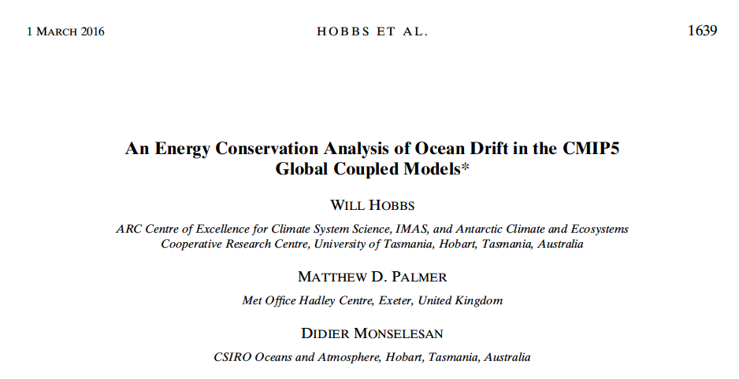
Physical insights
Most models are energy conserving once long-term leakage is accounted for
Energy leakage is typically time-constant & insensitive to forcing
Irving et al (2019)
Consider energy and moisture
Progress from CMIP5 to 6
Identify problematic CMIP6 models
Regional scales
Notes:
Will Hobbs then took a more physically based approach and looked at drifts in the global energy budget. In particular, he looked at the relationship between the netTOA energy imbalance and trends on OHC.
They found:
On decadal time scales there is a close relationship between top-of-atmosphere energy balance and ocean heat content. This indicates that the models are energy conserving once their long-term nonconservation terms are accounted for.
For most models the response to climate forcing does not seem to be affected by the magnitude of its energy bias or nonconservation term.
The nonconservation in these models is overwhelmingly characterized by a time-constant bias (i.e., the nonconservation is stationary). As well as being constant in time, the energy biases are largely insensitive to changes in the models’ forcing regimes (i.e., the nonconservation is the same for all experiments). This has a number of useful practical implications for the correction of model energy balances (e.g., in the calculation of equilibrium climate sensitivity) or for drift correction of global-mean state variables (e.g., ocean or surface air temperature). First, this result formally demonstrates that nonzero energy balances or drifts in a model’s control run can be safely used to correct variables in the same model’s perturbed experiments, as is commonly the case in studies requiring drift or energy balance correction.
We’re interested in:
Are there any models that can’t be used after drift removal? (For selfish reasons)
Has drift continued to improve from CMIP5 to CMIP6?
Extending the analysis to include mass and salt
Adding something to ESMValTool

Slide 5
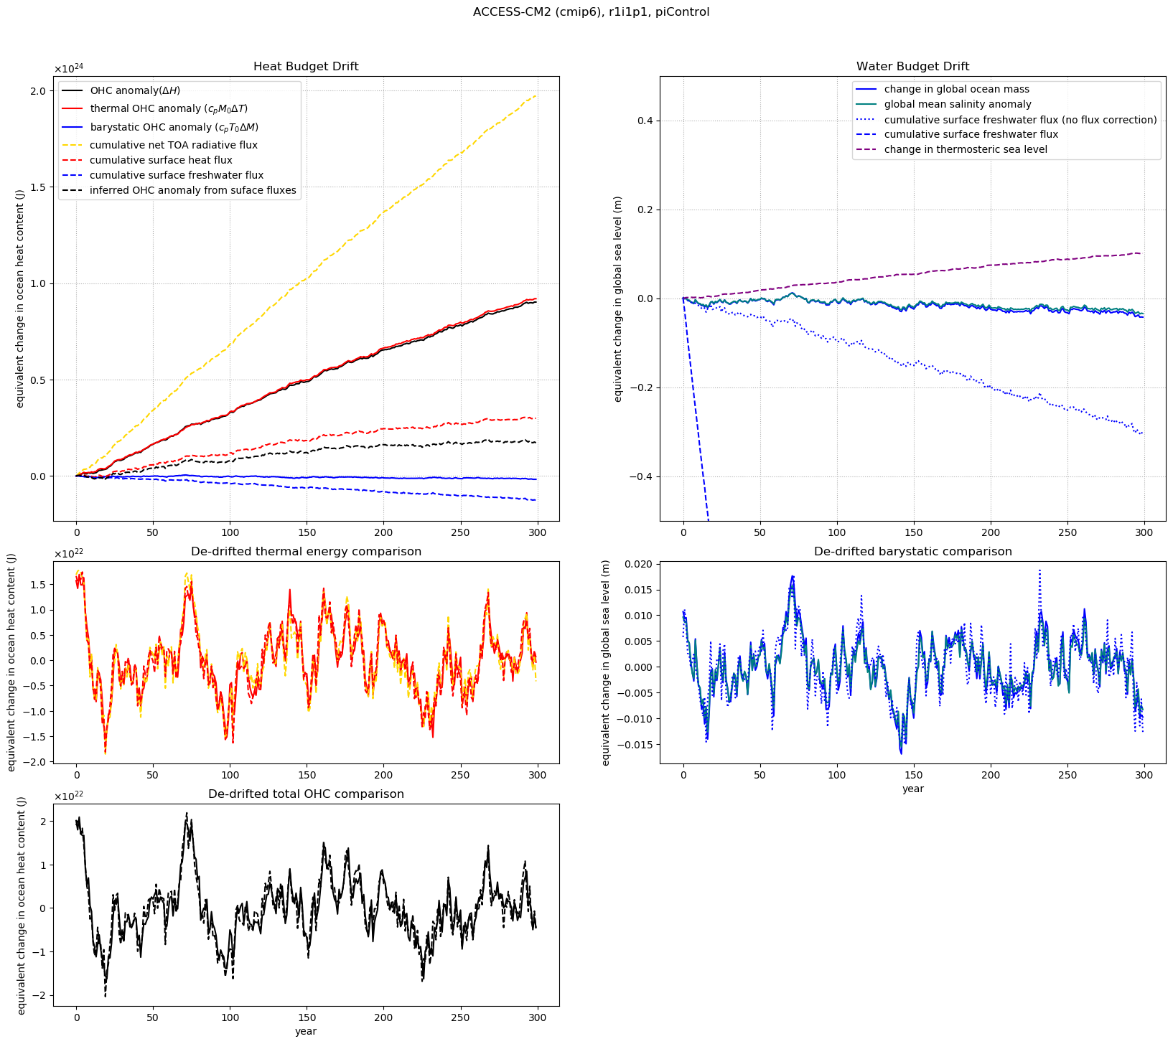
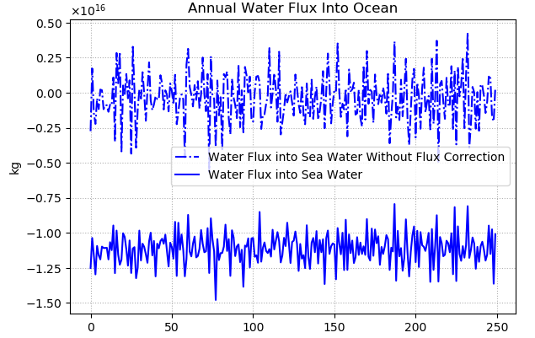
masso
thetaoga
hfds
wfo
soga
rsdt
rlut
rsdt
Notes:
Let’s put these decompositions into action with the ACCESS-CM2 control run (first 300 years).
Explain plot:
Timeseries that should match (red for thermal component of OHC, blue for mass component of OHC, black for total)
When you remove that drift by fitting and subtracting a polynomial, they should match (Hobbs found most models are energy conserving once the long term non-conservation is removed)
Main features:
Essentially all the OHC drift is attributable to the thermal rather than barystatic component
Most energy leakage is in the atmosphere
The drift in surface water flux is huge (issue with the data)
This model approximately conserves salt, but not energy or moisture, which implies that the ocean model is leaking…

Slide 6
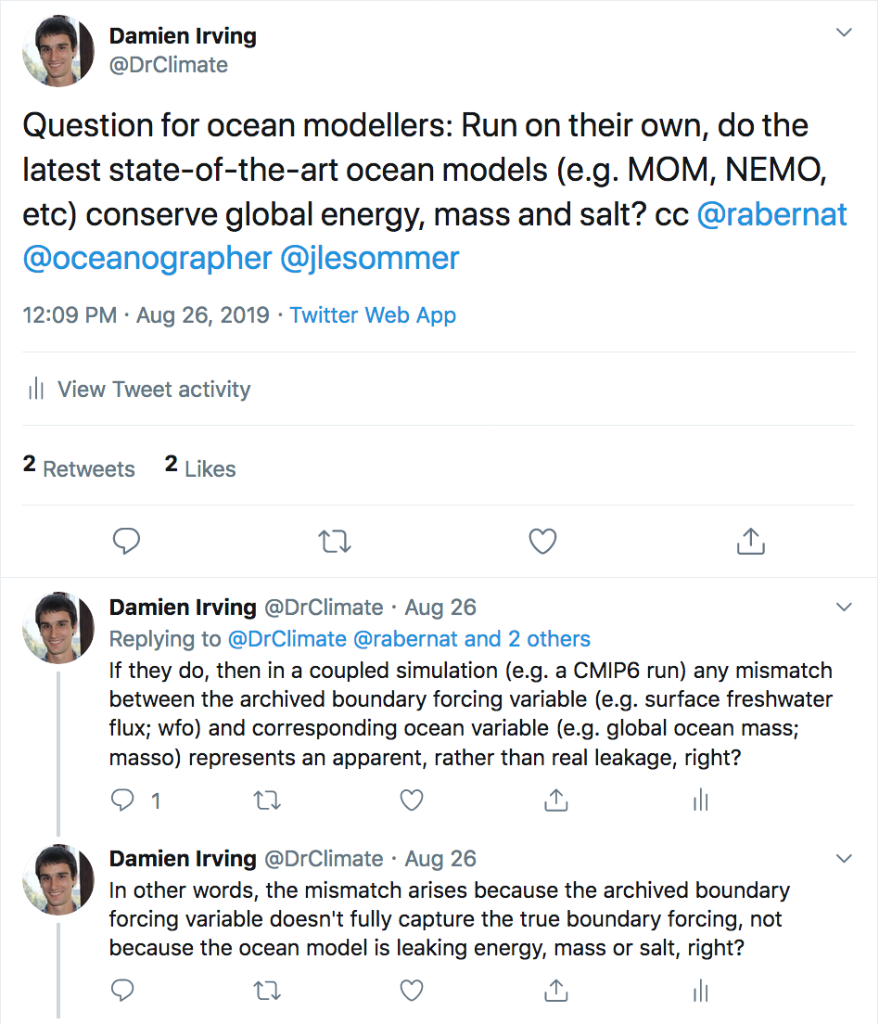
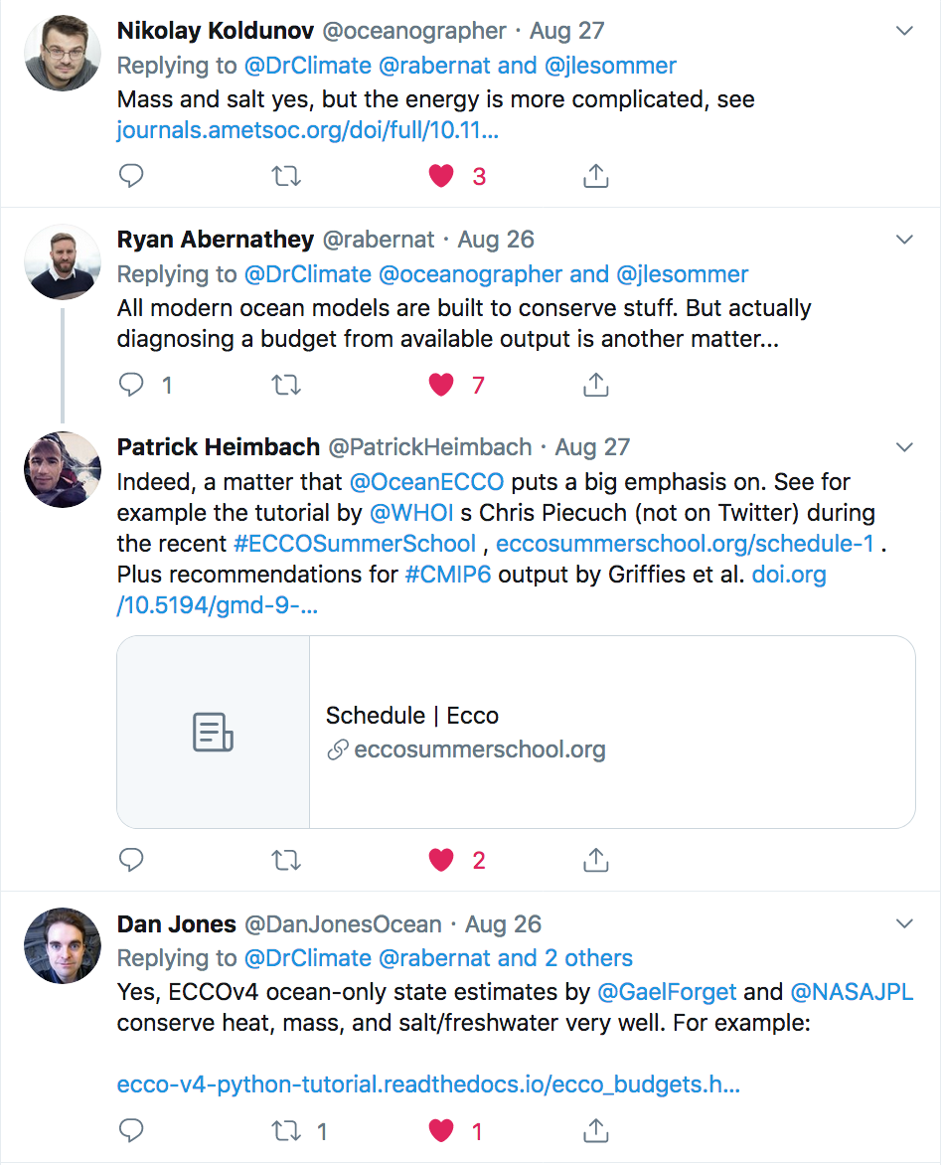
Notes:
I would argue that this moisture leak is ”apparent” as opposed to an actual problem with the MOM model itself.

Slide 7
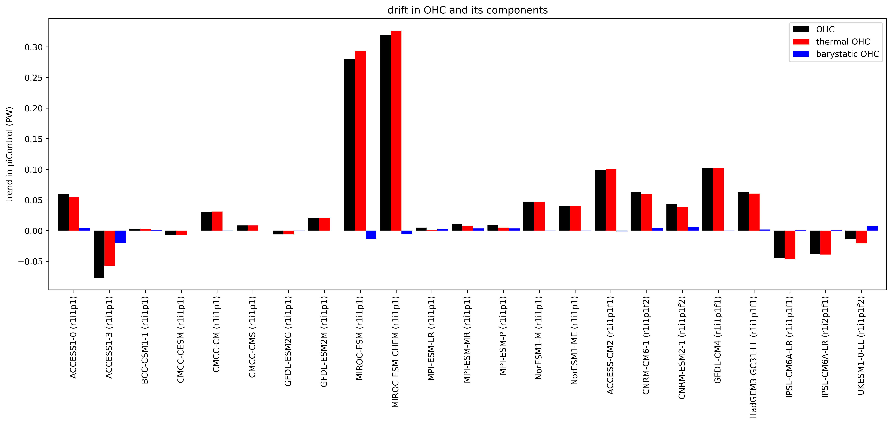
Drift in OHC
CMIP5
CMIP6
Notes:
Let’s put ACCESS-CM2 in context…
Describe the plot:
Linear trend in OHC content and it’s thermal and barystatic components
Ensemble is all the models that archived masso and thetaoga in CMIP6 (that I haven’t had some weird data problem with – some models have missing timesteps), and most of the CMIP5 models but not quite all yet.
Main features
Thermal dominates over barystatic for all models
Many more models have a positive OHC drift
Less crazy outliers in CMIP6 but larger drift in general
ACCESS-CM2: The OHC drift is relatively large

Slide 8
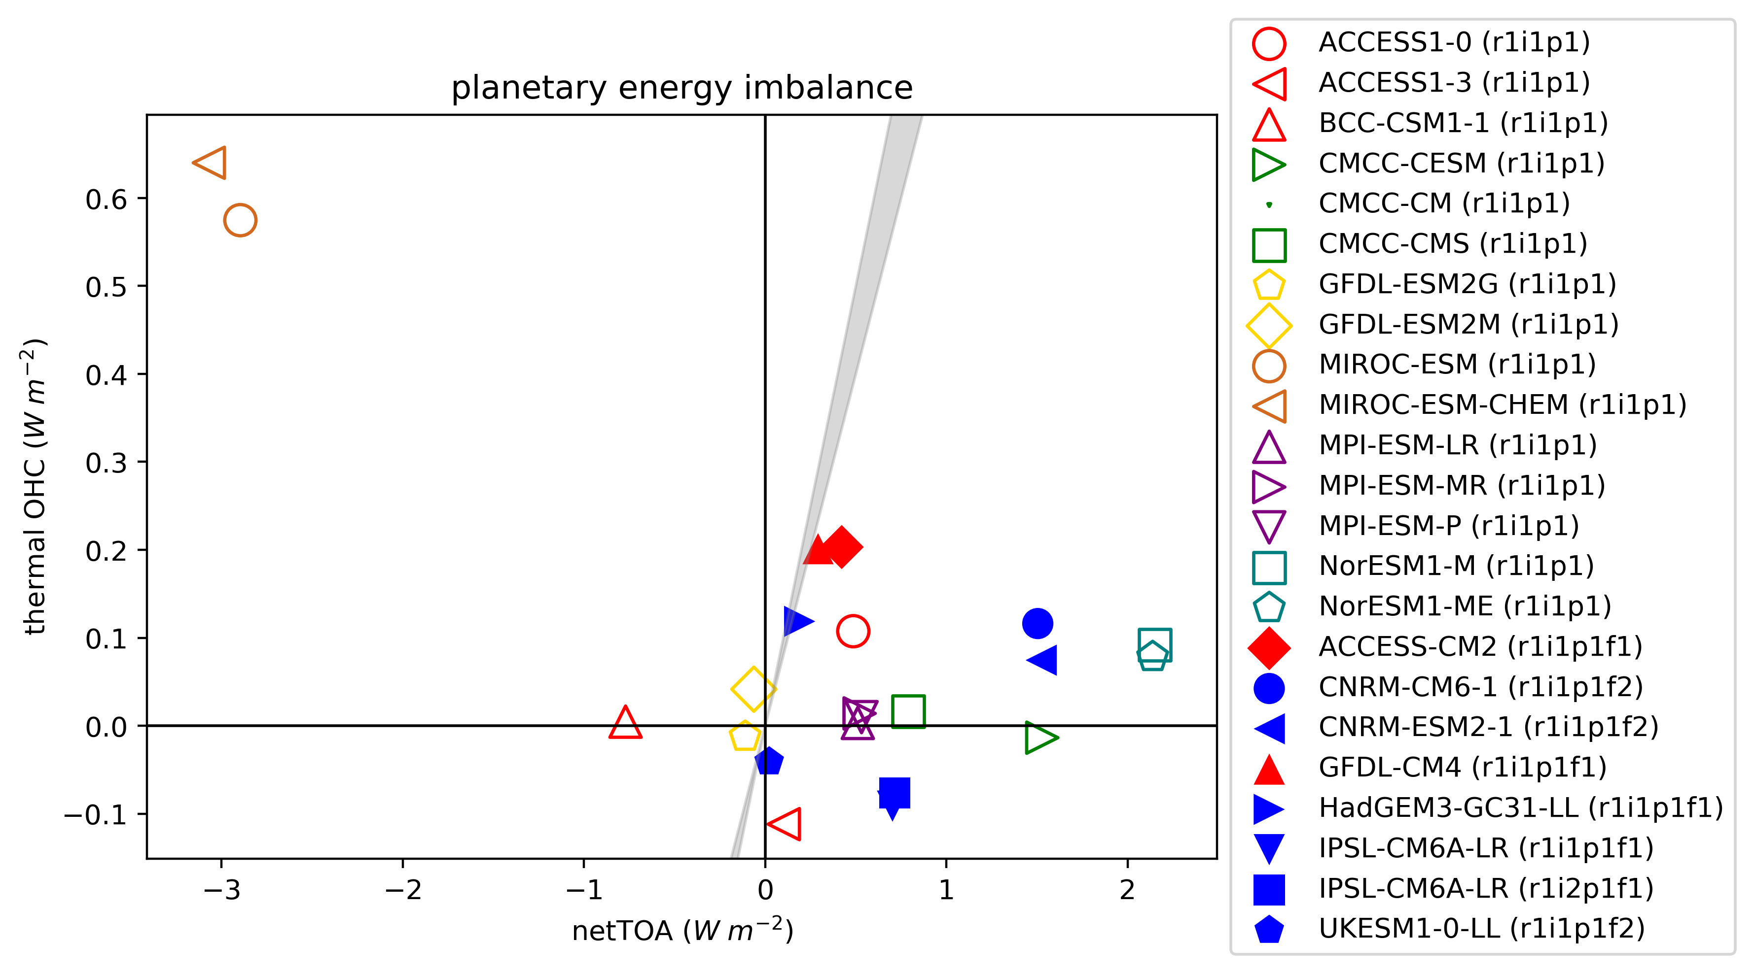
Planetary energy imbalance
For models to the right of the expected ocean storage range (80-100%, grey shading), there is a loss of energy between the TOA and ocean.
The current observed planetary energy imbalance is 0.5 - 1.0 Wm⁻²
Notes:
We can put those OHC drifts in context by comparing against the cumulative TOA radiative imbalance.
Describe these plots:
Open shapes = CMIP5; Solid shapes = CMIP6
Colors correspond to matching ocean model
Describe this particular plot:
We know from observations that about 90% of cumulative TOA energy imbalance is ultimately stored in the ocean.
So if the models were conserving energy, they would fall within the grey band.
Main features
As with ACCESS, the netTOA drift tends to be larger than the OHC drift (i.e. models leak)
ACCESS-CM2: The drift in netTOA is relatively small. So while the drift in OHC is relatively large, in some sense it’s because there isn’t as much leakage between the TOA and ocean as there is in other models (i.e. it’s one of the closest to the 80-100% band)

Slide 9
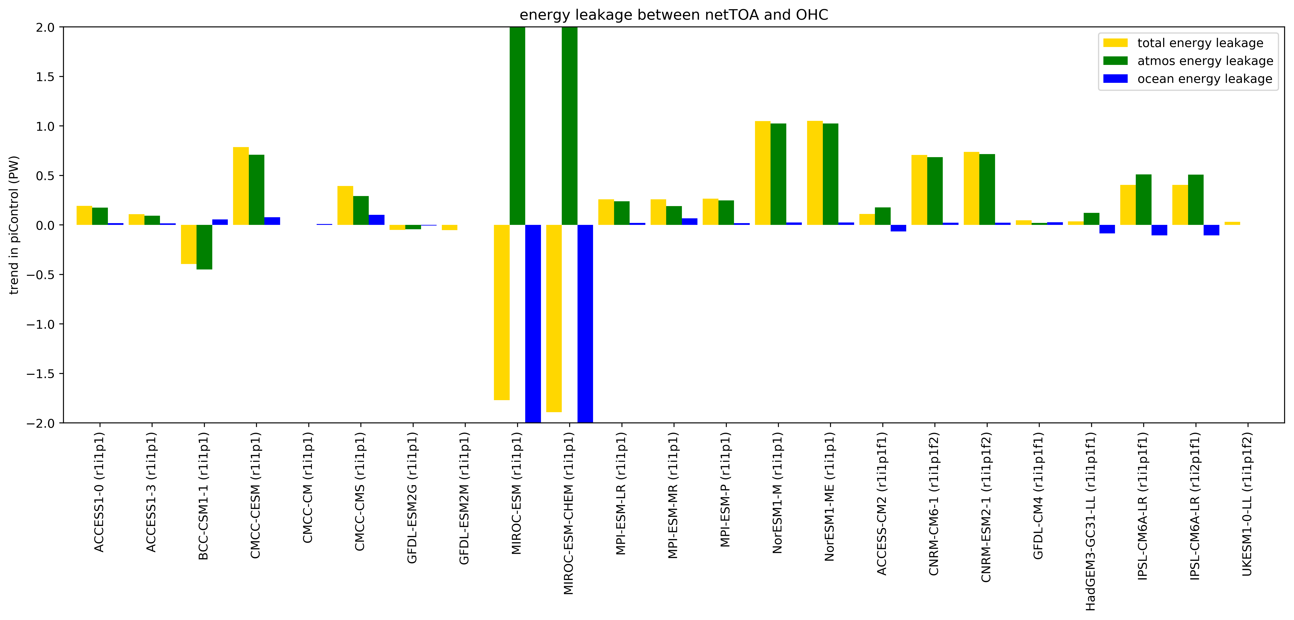
CMIP5
CMIP6
Notes:
Main features:
Most of the leakage between the TOA and ocean storage occurs in the atmosphere.
In the atmosphere that’s real leakage as opposed to apparent
Less overall leakage in CMIP6?
ACCESS-CM2 has less leakage than most

Slide 10
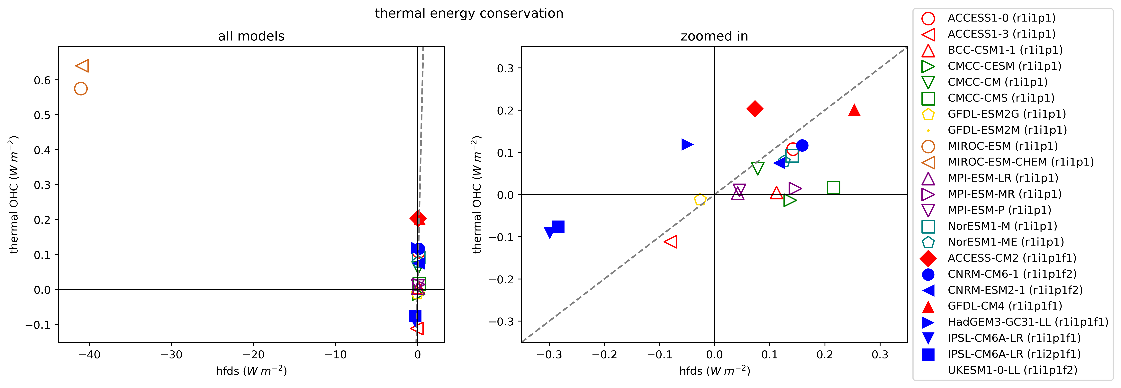
Ocean drift/conservation
For models below the line, there is an apparent loss of ocean heat.
The current observed planetary energy imbalance is 0.5 - 1.0 Wm⁻²
Notes:
Let’s now look at drift and conservation specifically in the ocean.
Features of this plot:
Thermal OHC vs cumulative surface heat flux
Zoomed in on the right
Most oceans lose heat
Less crazy outliers in CMIP6 (so far), but you wouldn’t say there’s an overall improvement in thermal energy conservation

Slide 11
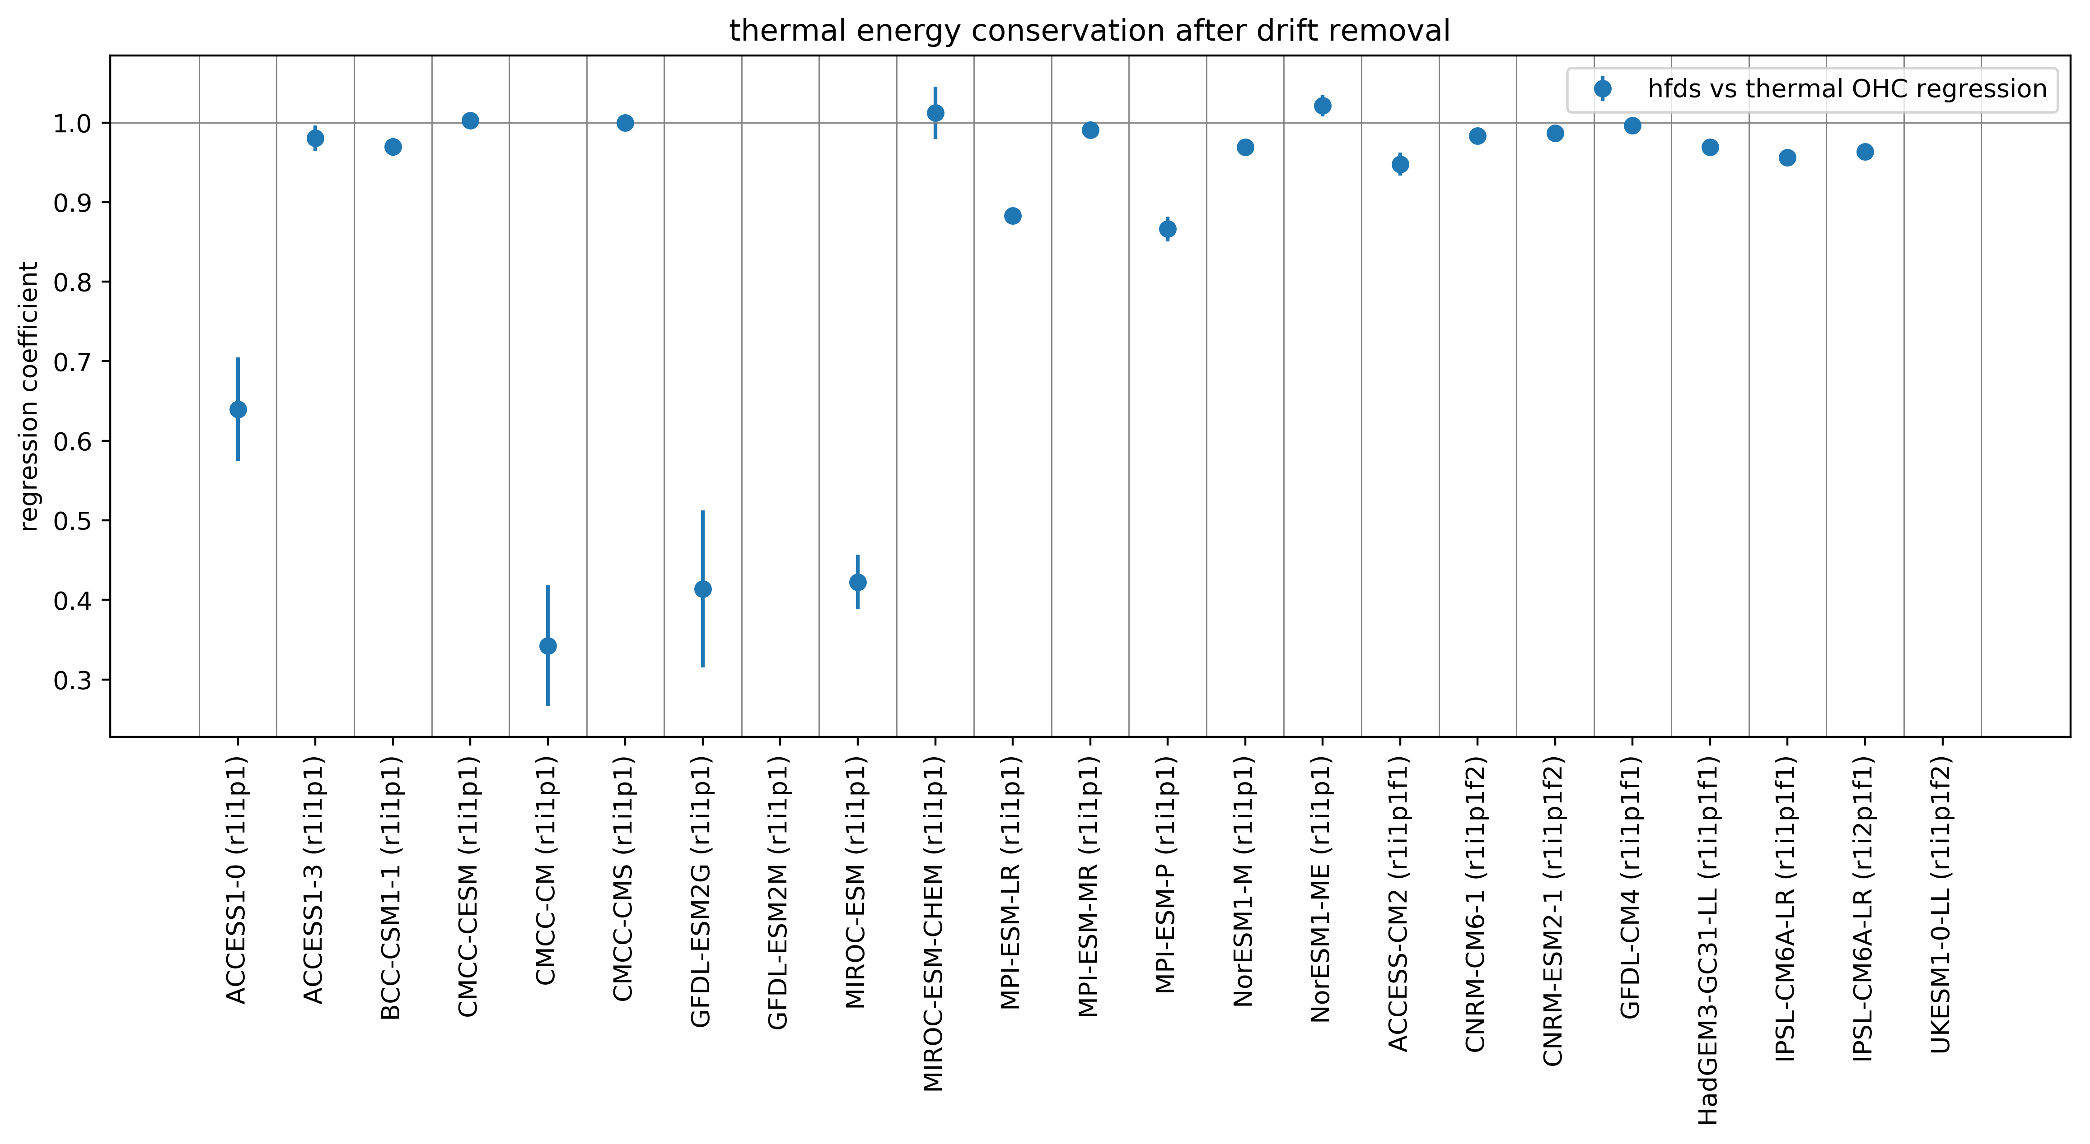
CMIP5
CMIP6
Notes:
All of the CMIP6 models I’ve looked at are energy conserving once the long term non-conservation is removed. (Unlike CMIP5 where there are outliers to be aware of).

Slide 12
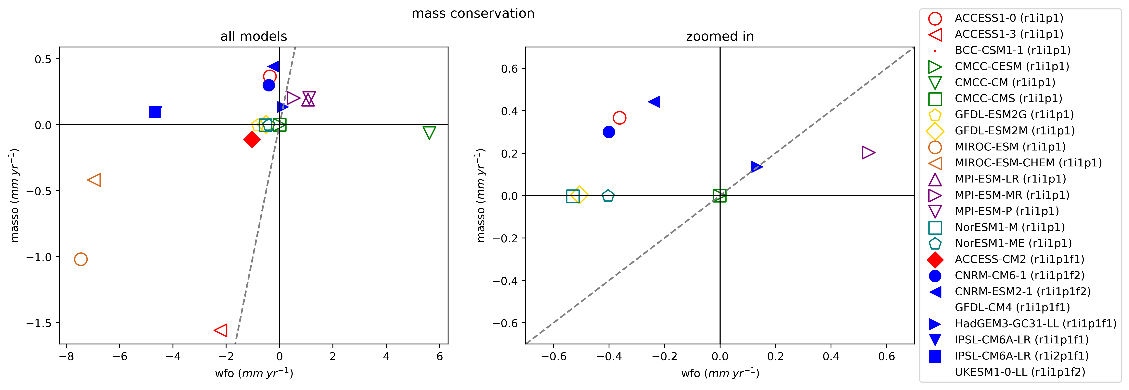
Not sure how to interpret constant volume Boussinesq models
For models below the line, there is an apparent loss of ocean heat.
The current observed rate of sea level rise is 3.4 mm/year (half of which is barystatic)
Notes:
Mass conservation is more difficult than energy conservation.
HELP: What do I do with the rigid lid models (i.e. models where mass doesn’t change)

Slide 13
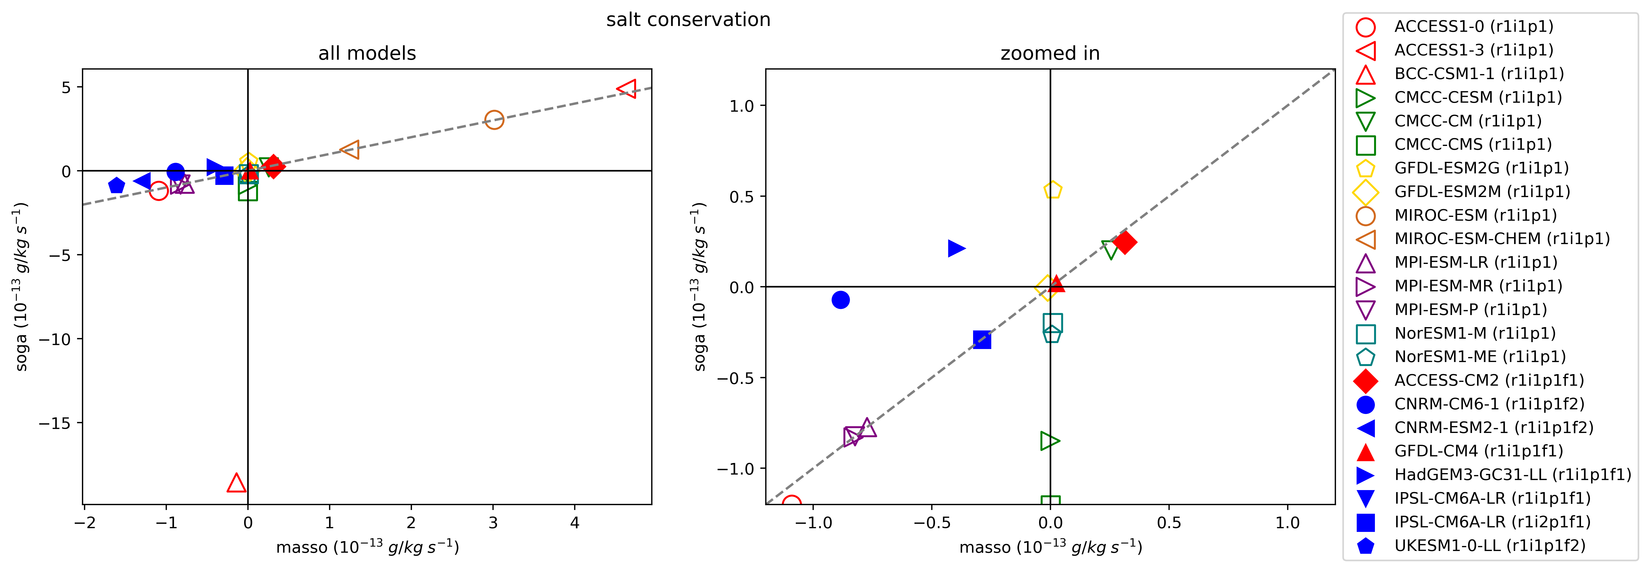
For models above the line, there is an apparent loss of ocean salt.
Notes:
Many models do a good job of conserving salt, except for ones where mass is constant.

Slide 14
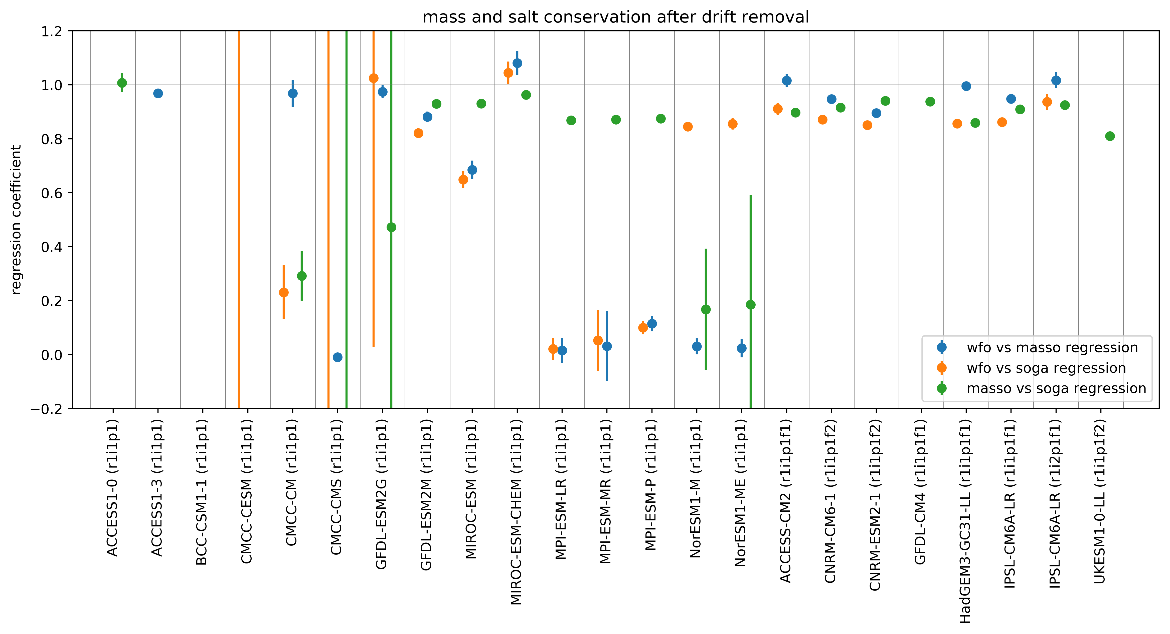
CMIP5
CMIP6

Slide 15
Summary
Mass conservation is more difficult than energy conservation
Drift magnitude has not improved from CMIP5 to CMIP6, but energy, mass and salt conservation has improved after accounting for long-term leakage
ACCESS-CM2 has relatively large OHC drift but relatively small energy leakage between TOA and ocean
TODO: Regional scales

Slide 16
Questions?
damien.irving@unsw.edu.au
Notes:
At regional scales there may be spurious redistributions of energy that are not evident in global integrals.

Slide 17


Analysis framework
masso
(or volo x rhozero)
cpocean
thetaoga
$$H=c_{p}MT$$
$$\frac{∂H}{∂t}=c_{p}M\frac{∂T}{∂t}+c_{p}T\frac{∂M}{∂t}$$
Thermal term
Barystatic term
Notes:
To learn more about drift and conservation in energy and mass, we break down the drift in OHC (i.e. the trend in the control run) into a thermal term and barystatic term (that accounts for changes in ocean heat content due to changes in in the mass of the ocean).
We simply calculate linear trends for these time derivatives.
For those familiar with working with CMIP variables, I’ve got them on the screen. Note that most ocean CMIP ocean models apply a Boussinesq approximation, which means volume (as opposed to mass is conserved in the absence of any freshwater flux). In CMIP6 the masso variable is supposed to be volo times the reference density to account for that (ACCESS follows the rules, which is great), but many modelling groups clearly didn’t update their diagnostics packages since CMIP5.
This decomposition is interesting in its own right, as it helps to diagnose the reason for long-term ocean model drifts. It’s also useful in looking at conservation…

Slide 18





Thermal energy conservation
hfds
$$c_{p}M\frac{∂T}{∂t}≈\frac{dQ^{h}}{dt}$$
$$Q^{h}\left(t\right)= \int_{0}^{t}{\int_{i}{\int_{j}{q^{h}\left(t, i, j\right) dA dt}}}$$
Mass conservation
Accumulated surface heat flux
areacello
wfo
$$\frac{dM}{dt}≈\frac{dQ^{m}}{dt}$$
$$Q^{m}\left(t\right)= \int_{0}^{t}{\int_{i}{\int_{j}{q^{m}\left(t, i, j\right) dA dt}}}$$
Salt conservation
Accumulated surface mass flux
soga
$$ΔS=S_{0}\left(\frac{M_{0}}{M_{t}}−1\right)$$
Notes:
In a correctly balanced ocean model that is in equilibrium (i.e. spinup is complete):
Drift in the thermal component of the ocean heat content should (on annual and longer timescales) approximately equal the cumulative net surface heat flux
Drift in the barystatic component of the ocean heat content should approximate the cumulative net freshwater flux
We also repeat the thermal balance calculation for netTOA.
Finally, ocean models should also conserve salt. A change in the global ocean mass can be related to an equivalent change in global average salinity as shown.

